Slide 1
Forecasting Optimal
Inventory Levels
A Time Series Analysis
by Joe Flatt

Slide 2
What is the right level of inventory?
All businesses rely on sales. Businesses that use products will have inventory requirements to make sure sales are handled timely and appropriately. A company will likely need to keep a cap on inventory in an effort not to overspend on inventory during a slow-sales period.
Oftentimes a company knows when their busy and slow seasons are (Christmas, Black Friday, different seasons, etc.) and thus they can prepare inventory accordingly. It is the other times of the year where a company could benefit from Time Series analysis for surprise sales increases/decreases.

Slide 3
What is the right level of inventory?
With Time Series analysis, I analyzed inventory & sales data to forecast optimal inventory according to sales needs throughout the year. My solution could help optimize the appropriate amount of inventory to stock according to sales during different parts of the year.
From a logical standpoint, inventory and sales should have some sort of correlation - the more something sells, the more need for inventory of that specific item. This project aims to see how closely related inventory and sales are and what events may fluctuate their relationship.

Slide 4
Data
The U.S. Bureau of the Census monthly inventory & sales data from January 1st, 1992 - October 1st, 2018, retrieved from FRED, Federal Reserve Bank of St. Louis: U.S. Bureau of the Census, Total Business Inventories [BUSINV], retrieved from FRED, Federal Reserve Bank of St. Louis https://fred.stlouisfed.org/series/BUSINV
U.S. Bureau of the Census, Total Business Sales [TOTBUSSMSA], retrieved from FRED, Federal Reserve Bank of St. Louis https://fred.stlouisfed.org/series/TOTBUSSMSA

Slide 5
Data
“The Manufacturing and Trade Inventory and Sales estimates are based on data from three surveys: The Monthly Retail Trade Survey (MRTS), the Monthly Wholesale Trade Survey (MWTS), and the Manufacturers' Shipments, Inventories, and Orders Survey (M3).”
-U.S. Bureau of the Census

Slide 6
Data
Inventories - Retail - Merchandise inventories are the value of stocks of goods held for sale.
Inventories - Manufacturing - Total inventories represent the value of the end-of-month stocks regardless of stage of fabrication (whether in the form of purchased materials and supplies, work in process, or finished goods).

Slide 7
Data
Sales - Retail - Sales include merchandise sold (for cash or credit at retail or wholesale) by establishments primarily engaged in retail trade. Services that are incidental to the sale of merchandise, and excise taxes that are paid by the manufacturer or wholesaler and passed along to the retailer are also included.
*Units are in millions of dollars

Slide 8
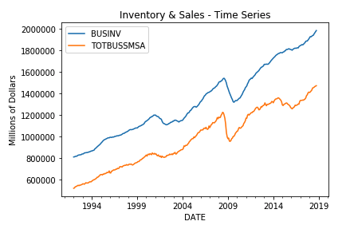
Exploratory Analysis
One entry per month = 322 total entries
322/12 = 26.83, almost 27 years of data
Inventories and Sales show very similar patterns with an overall increase since 1992; however, there are declines from 2001-2002 and 2008-2010.
Sales has a slight dip from 2014-2016 which is not observed for Inventory.

Slide 9
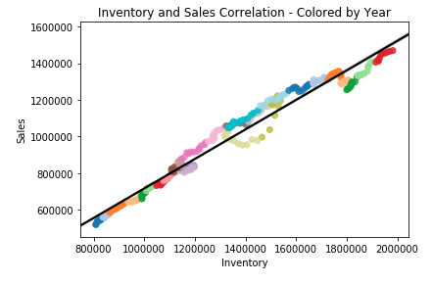
Exploratory Analysis
From the results on this chart, we can see that there is a strong correlation between sales and inventory values (r value = 0.984).

Slide 10
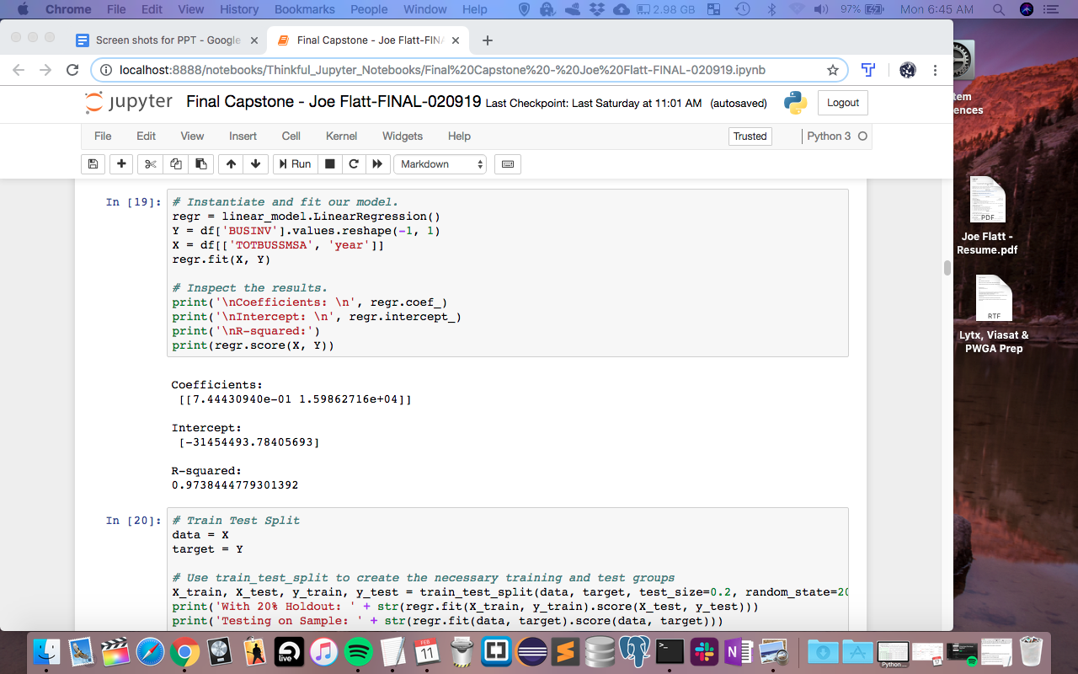
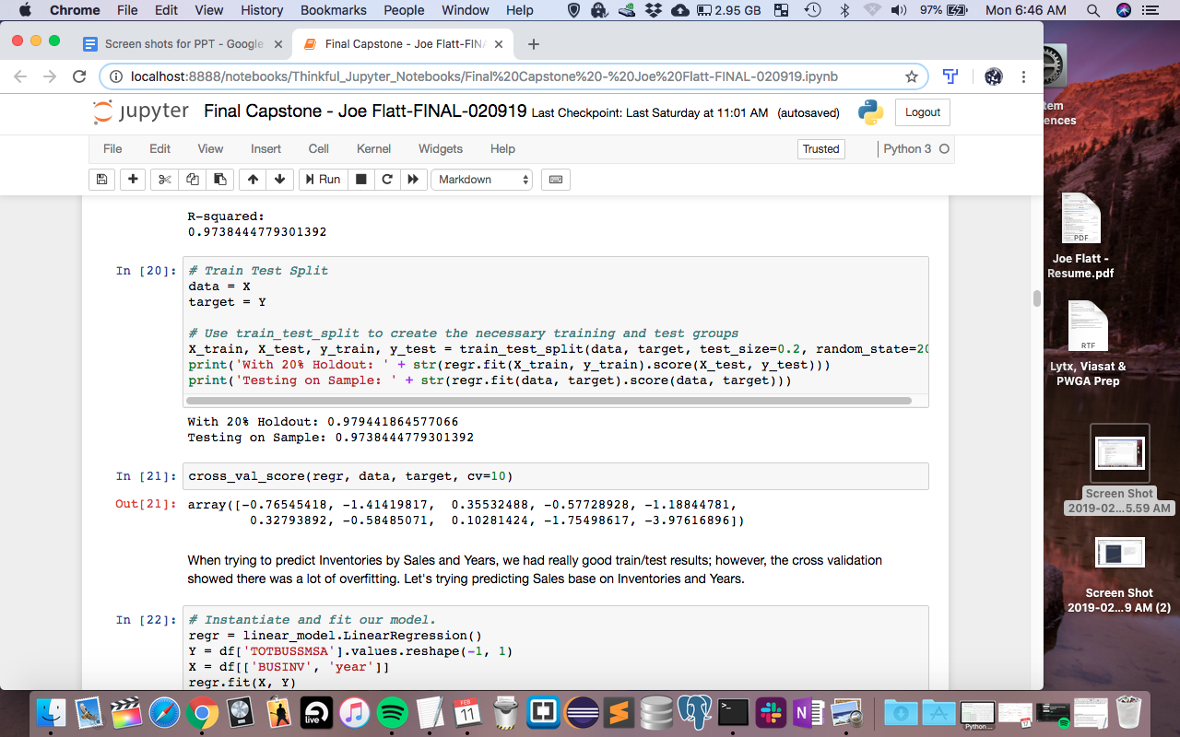
Linear Regression
When trying to predict Inventories by Sales and Years, there were really good train/test results but poor cross validation results.
Linear Regression does not take into effect time like an ARIMA model does.
What was observed in the cross validation is overfitting. Overfitting is when your model catches extra, random noise in its analysis instead of finding the true underlying relationships.
Tried several other machine learning models; however, none provided good results - Neural Network, Random Forest, KNN, Logistic Regression, Ridge Regression, Lasso Regression, SVM.

Slide 11
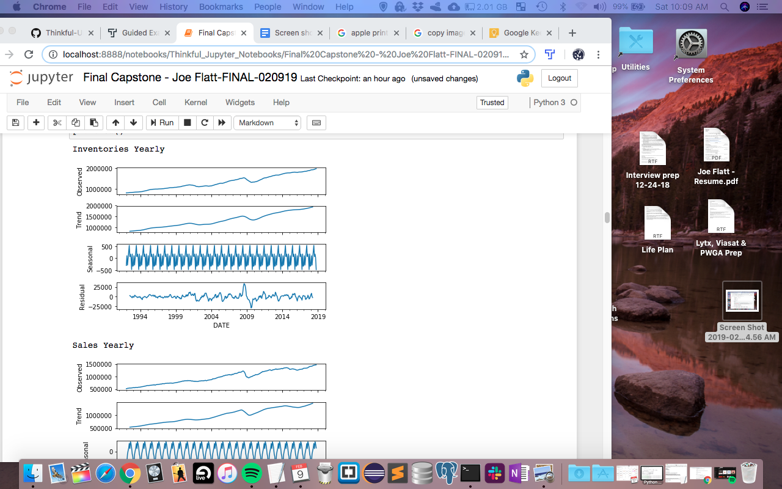
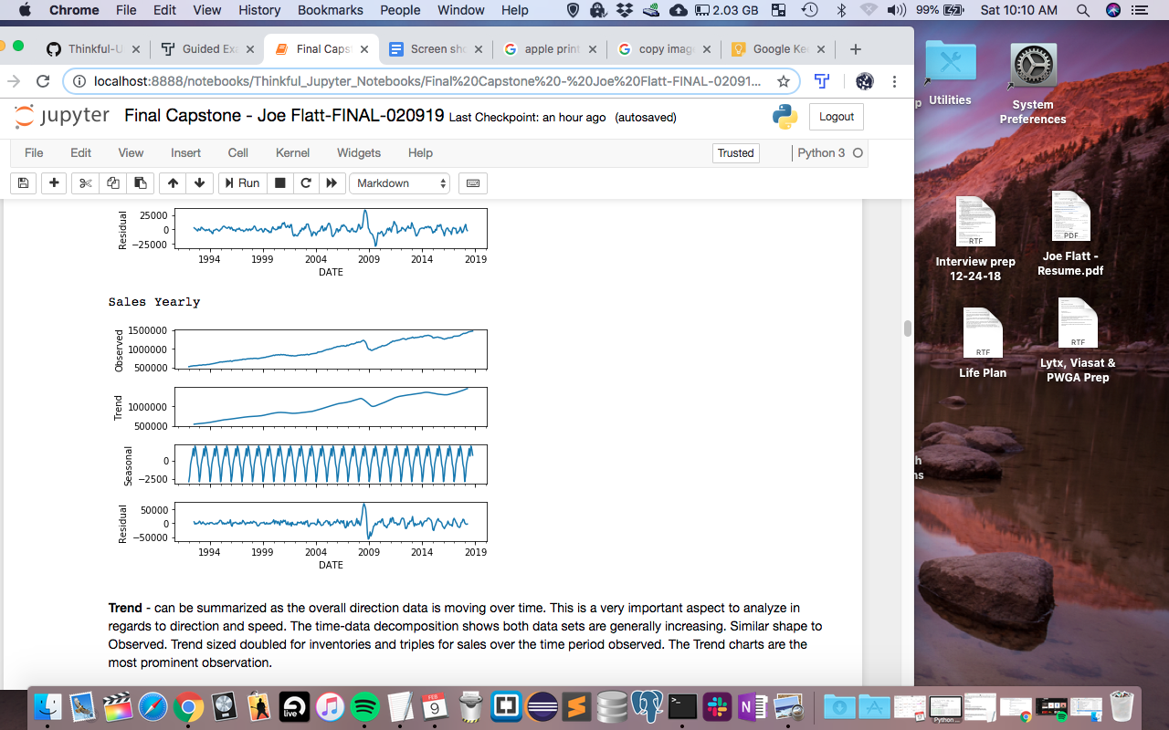
Seasonal Decomposition
Inventory and Sales Yearly data broken down into Observed, Trend, Seasonal and Residual.

Slide 12
Seasonal Decomposition
Trend - can be summarized as the overall direction data is moving over time. This is a very important aspect to analyze in regards to direction and speed.
The time-data decomposition shows both data sets are generally increasing. Similar shape to Observed. Trend sized doubled for inventories and tripled for sales over the time period observed. The Trend charts are the most prominent observation.

Slide 13
Seasonal Decomposition
Seasonal - should show repeating cycles over a period of time (think certain items sell better at different times of the year). The time-data decomposition shows a repeating short term cycle in a series - this is what we expect since data is continuous. Inventories look to have their spike slightly before the seasonal sales spike (middle of year). This makes sense as businesses typically know when to increase their inventory in anticipation of a busy sales season.

Slide 14
Seasonal Decomposition
Residual - the difference between the prediction and observed quantity. A good residuals representation will have show no correlation and have a mean of 0. The time-data decomposition shows very similar patterns between inventories and sales - has no correlation and a mean of 0 as expected.

Slide 15
Model Preparation
65 month history will be used for the model
Stationarity is present when a data set has statistical properties (mean, variance, etc.) constant over time. One way to test for stationarity is the Augmented Dickey-Fuller (ADF) test. If p < 0.05, we reject the null hypothesis and assume the alternate hypothesis of stationarity. If p > 0.05, we accept the null hypothesis of non-stationarity. If the data set is non-stationary, using differencing will be required to make it stationary.

Slide 16
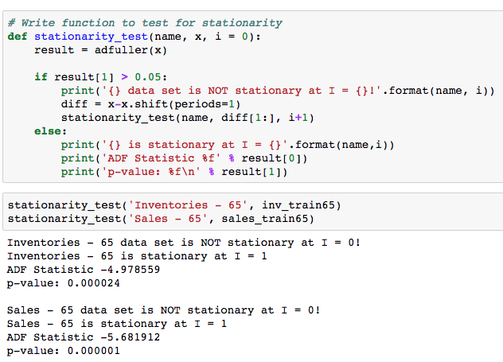
Stationarity Test Results
Results from the ADF test show that our data is not stationary at I = 0, but they are stationary at I = 1.

Slide 17
ARIMA
ARIMA is an acronym that stands for AutoRegressive Integrated Moving Average. This acronym is descriptive, capturing the key aspects of the model itself. Briefly, they are:
AR: Autoregression - A model that uses the dependent relationship between an observation and some number of previous (lagged) observations.
I: Integrated - The use of differencing of raw observations (subtracting an observation from an observation at the previous time step) in order to make the time series stationary.
MA: Moving Average - A model that uses the dependency between an observation and a residual error from a moving average model applied to lagged observations.

Slide 18
ARIMA
The parameters of the ARIMA model are defined as follows:
p: The number of lag observations included in the model, also called the lag order.
d: The number of times that the raw observations are differenced, also called the degree of differencing.
q: The size of the moving average window, also called the order of moving average.

Slide 19
PACF
The Partial Autocorrelation Function represents the correlation of our time series with a lagged version of itself. The high correlations will help us with our ARIMA modeling. This is a method to estimate the lag order and provides a visual way to analyze the differencing.

Slide 20
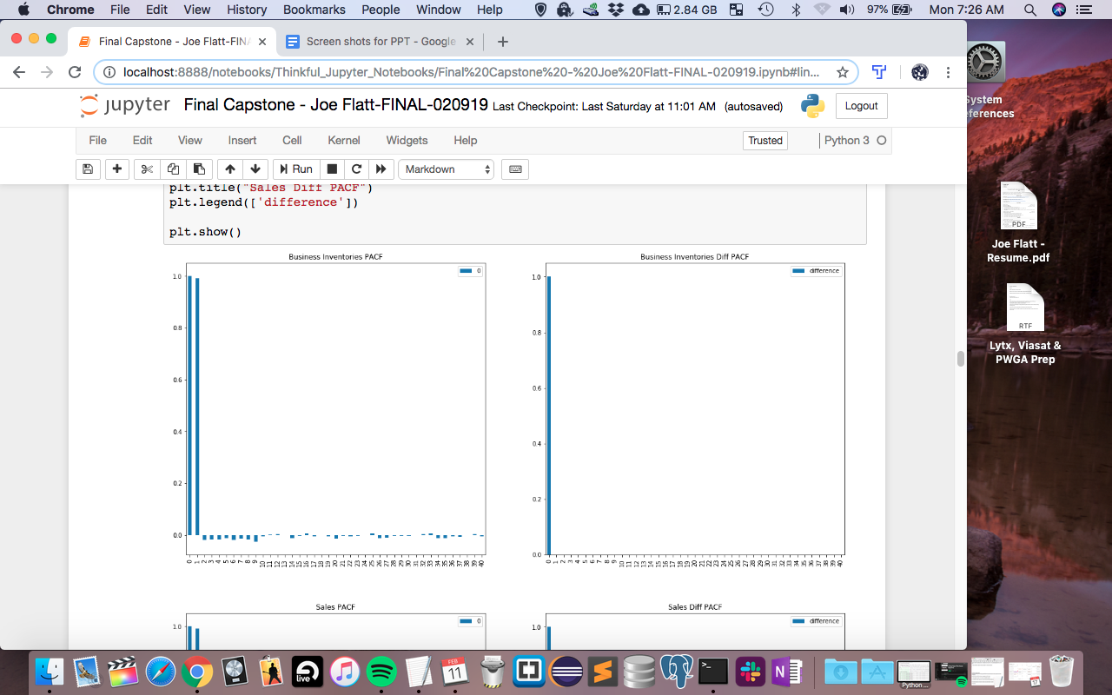
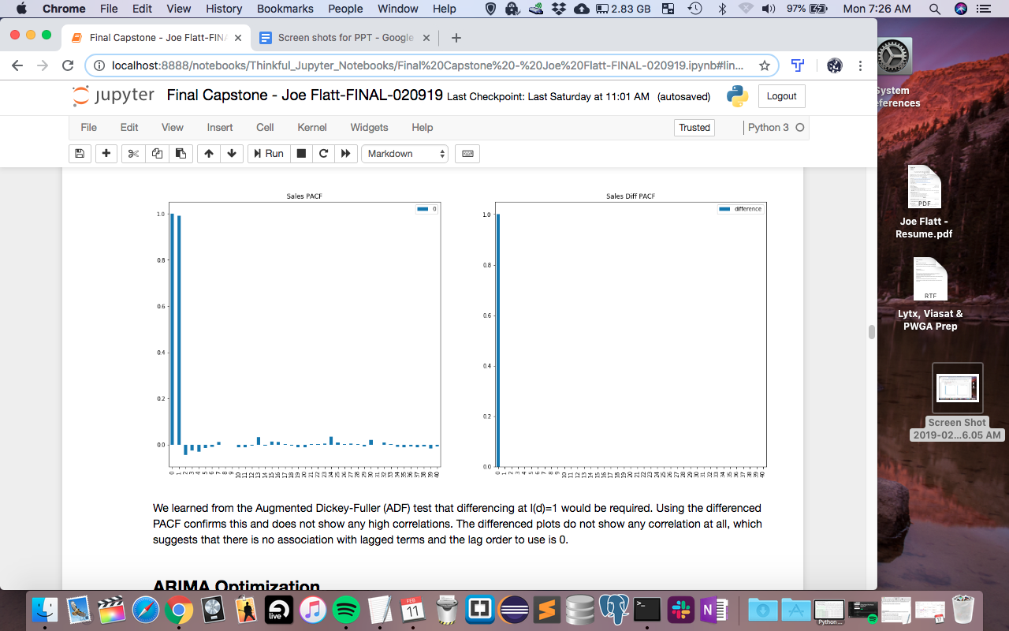
PACF

Slide 21
PACF
We learned from the Augmented Dickey-Fuller (ADF) test that differencing at I(d)=1 would be required. Using the differenced PACF confirms this and does not show any high correlations.
The differenced plots do not show any correlation at all, which suggests that there is no association with lagged terms and the lag order to use is 0.

Slide 22
ARIMA Optimization
I used a custom set of functions (via Github) that are defined to fit and test various ARIMA configurations and determine the best model for the data using a grid exploration. The Akaike Information Criteria (AIC) is a measure of the degree of information contained in the model. We would normally choose the lowest AIC value provided by statsmodels that minimizes information loss.

Slide 23
ARIMA Optimization
This search uses a range of model configurations to make predictions and test those predictions against known values. This will provide us with a AR(p), I(d), MA(q) configuration that minimizes mean squared error. "In statistics, the mean squared error or mean squared deviation of an estimator measures the average of the squares of the errors—that is, the average squared difference between the estimated values and what is estimated. MSE is a risk function, corresponding to the expected value of the squared error loss." Wikipedia

Slide 24
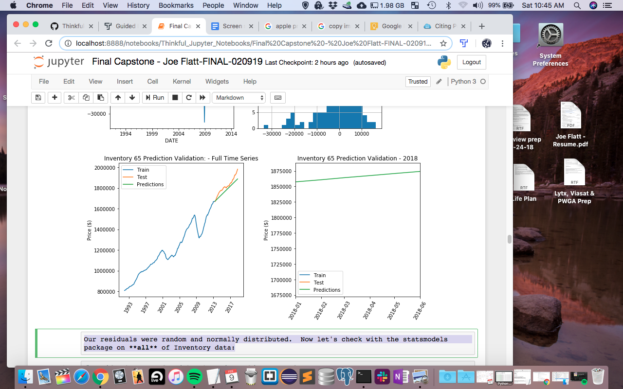
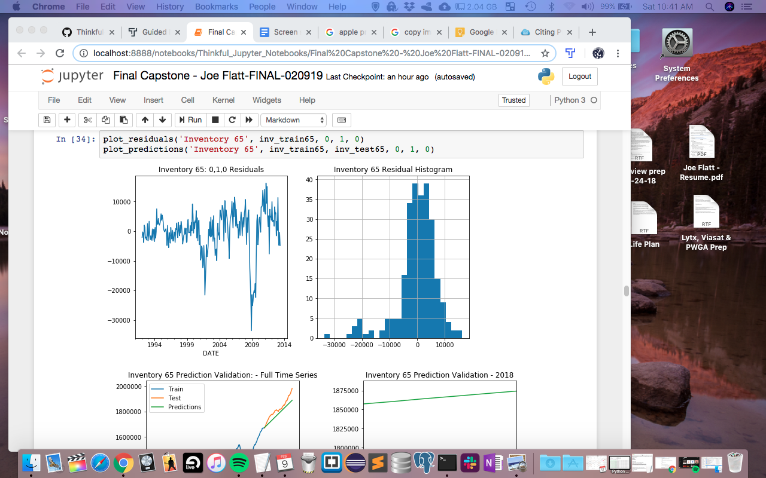
Inventory Models
Our residuals are random and normally distributed.

Slide 25
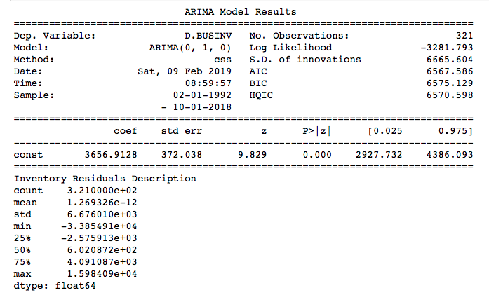
Inventory Models

Slide 26
Inventory Models
Our residuals were random and normally distributed.
Our constant of 3656.9128 is our expected increase in value for each day.
Our p-value is less than 0.05, so that gives more than the 95% confidence interval that the coefficient has a significant effect on our outcome.
After calculating MSE and determining that we have low information loss, ARIMA (0,1,0) should be the best model to use for the Inventory Data.

Slide 27
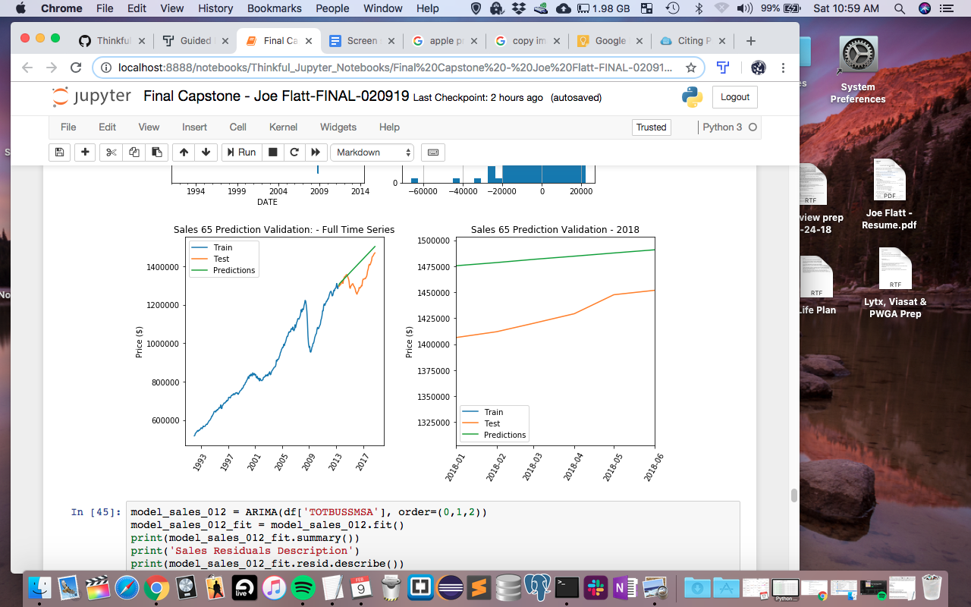
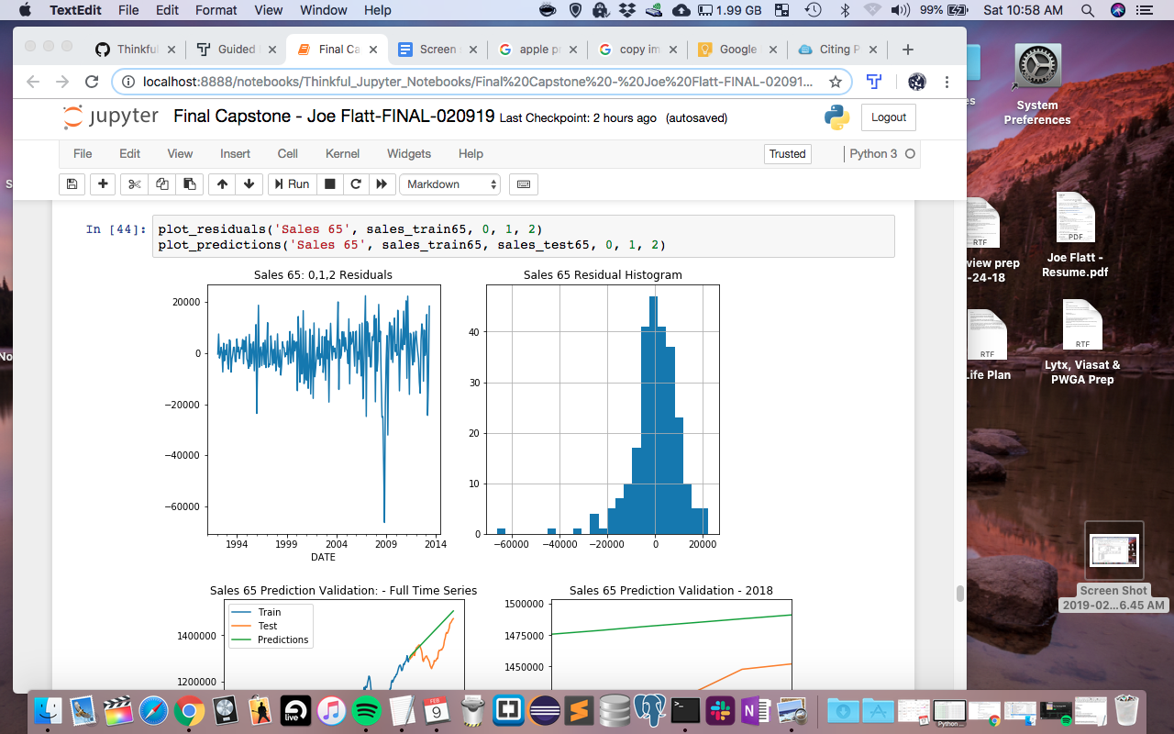
Sales Models
Using the same processes as we did with the inventory data, the best configuration for sales data came out to be (0,1,2).

Slide 28
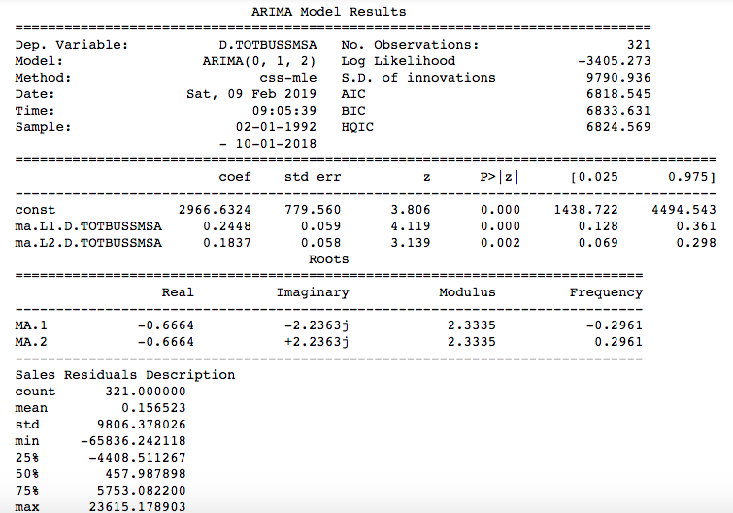
Sales Models

Slide 29
Further Exploration
SARIMAX
SARIMAX stands for Seasonal Autoregressive Integrated Moving Average and is an extension of ARIMA that supports univariate time series data with a seasonal component. The "X" addition supports exogenous (external factor) variables.
In addition to the trend elements of ARIMA, SARIMAX has an additional four seasonal elements: P: Seasonal autoregressive order. D: Seasonal difference order. Q: Seasonal moving average order. m: The number of time steps for a single seasonal period. Altogether, the parameters for SARIMAX are SARIMA(p,d,q)(P,D,Q)m. "Exog" is our "X" factor.

Slide 30
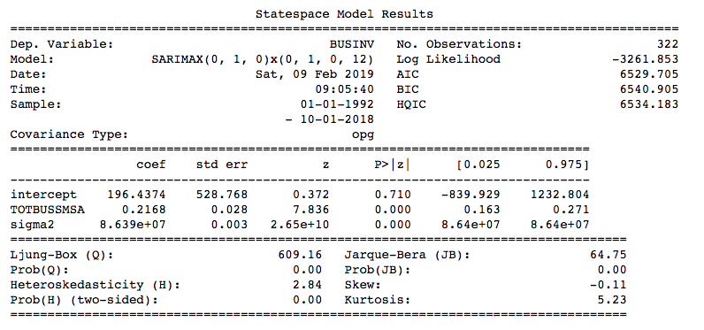
SARIMAX

Slide 31
SARIMAX
The intercept is the same as the constant; however, our data is differenced so the intercept is not significant. About 22% of the value of sales contributes to the inventory values. Not all of our p-values are less than 0.05, so further adjusting of the P,D,Q parameters would need to be done to get our best model configuration. Since seasonality had a small effect compared to trends, our ARIMA models should suffice for this data.

Slide 32
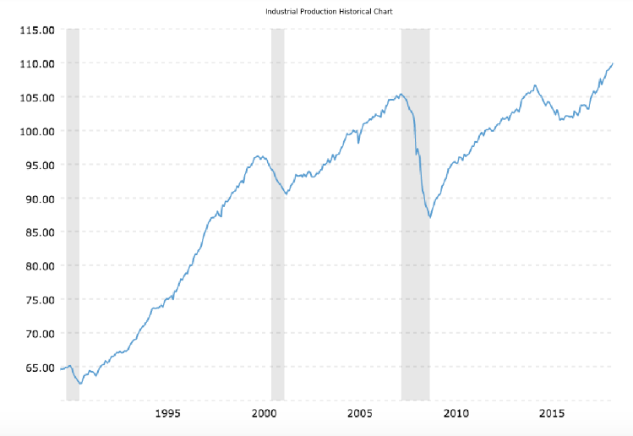
Economic Factors
This chart from Macrotrends tracks the Federal Reserve's Industrial Production Index, which measures real output for all facilities located in the United States manufacturing, mining, and electric, and gas utilities (excluding those in U.S. territories).

Slide 33
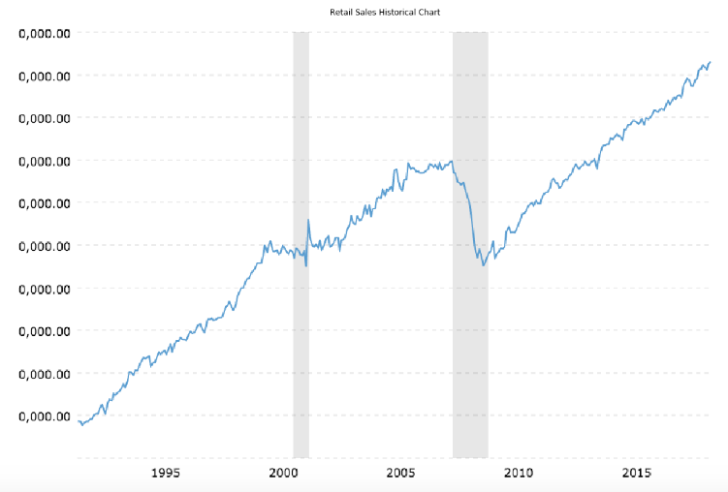
Economic Factors
This chart from Macrotrends displays total real (inflation-adjusted) retail and food service sales since 1992. The data is adjusted for inflation using the headline consumer price index.
Note: The picture file downloaded with the y axis not labelled correctly. The far left data point is 118,643 USD and the far right is 203,076 USD.

Slide 34
Economic Factors
The charts from Macrotrends look very similar to the Inventory and Sales data used throughout the notebook.
The recessions (grey shaded areas) in the Macrotrends charts line up with the dips we had in the original data as well. While it is good to see that our results look similar to the data from Macrotrends, this would be a good place to further research other factors that affect inventory and sales data - world events, unemployment rates, housing market, etc.

Slide 35
Summary
The analysis throughout this notebook gave us a good framework to apply to different data sets. Seasonal Decomposition showed us how to find our trends, seasonality, and residuals. Trend - showed both data sets are generally increasing. Similar shape to Observed. Trend sized doubled for inventories and triples for sales over the time period observed. The Trend charts are the most prominent observation.

Slide 36
Summary
Seasonal - Repeating short term cycle in a series - this is what we expect since data is continuous. Inventories look to have their spike slightly before the seasonal sales spike (middle of year). This makes sense as businesses typically know when to increase their inventory in anticipation of a busy sales season. The seasonality for this data had a small effect compared to the trends.
Linear Regression - This verified that while our data did have a lot of correlation, the element of time was needed to properly predict future values. Further exploration could determine other factors playing into the correlation between Inventories and Sales as well.

Slide 37
Summary
ARIMA modeling helped us determine our the optimal parameters for our best possible prediction. We verified our constant coefficient values from the differencing charts and made sure our p-values were low enough to ensure the models were giving optimal predictions.
SARIMAX modeling help us factor in seasonality and exogenous factors to further improve our modeling. Further exploration of the P,D,Q parameters could be done to optimize our model; however, since seasonality had a small effect compared to trends, our ARIMA models should suffice for this data.

Slide 38
Summary
The charts from Macrotrends confirmed that our original data was an accurate representation of inventory and sales data in the US. Data from FRED and Macro Trends all looked very similar when charted out.
By exploring the given data, setting up the proper parameters, determining the best model to use, and further verifying with outside factors, this set up could be useful to other companies looking to optimize their inventory. If a company knew how much sales they were expecting based on their past sales numbers, they could adjust inventory accordingly by increasing/decreasing at the appropriate time.

Slide 39
Summary
Decreasing inventory is easy to do, but increasing would bring up important decisions such as renting a temporary storage unit. Companies could prepare for a general increase in inventory rather than a seasonal increase and be better prepared, thus saving time and having a better idea of how they will need to operate in the future.

